Slide 1
Chapter 6
User-Defined Functions

Slide 2
Learning Outcomes
At the end of this chapter, you should be able to:
Understand the two types of functions.
Identify the three function elements.
Develop a program using functions.

Slide 3
Introduction
Programs can be as short as one line of code or millions of lines of code.
Small programs can easily be developed using only one function, which is the main function.
However, most computer programs that solve real-world problems are large and contain thousands to millions of lines of code.
Thus, more than one programmer or a team of programmers are needed to develop such programs.

Slide 4
Introduction (cont.)
In order to develop and maintain large programs, an effective way to construct it is by using functions.
Functions can efficiently break down large programs into smaller ones as they can divide problems into sub problems called modules.
Every function is a program segment that can do specific tasks.
  Each of the sub tasks can be coded as functions that must go together with the main function to build up a complete program.

Slide 5
Introduction (cont.)
Below are the advantages of using functions:
1. Functions break the program into smaller chunks,
making it easier for the programmer to code, test and
debug the program.
2. Each of the functions is reusable, where the function
can be called many times.
3. By using functions, repeating code in a program can be avoided.
The explanations above refer to user-defined functions.
There is another function known as the predefined function.
  available in the C++ standard library.

Slide 6
Function Types
Pre-defined
Function
Also known as mathematical library functions.
User-defined Function
Functions which are defined by the user.
These functions are available in the C++ standard library such as math.h and others.
The functions that programmers create for specialized tasks.

Slide 7
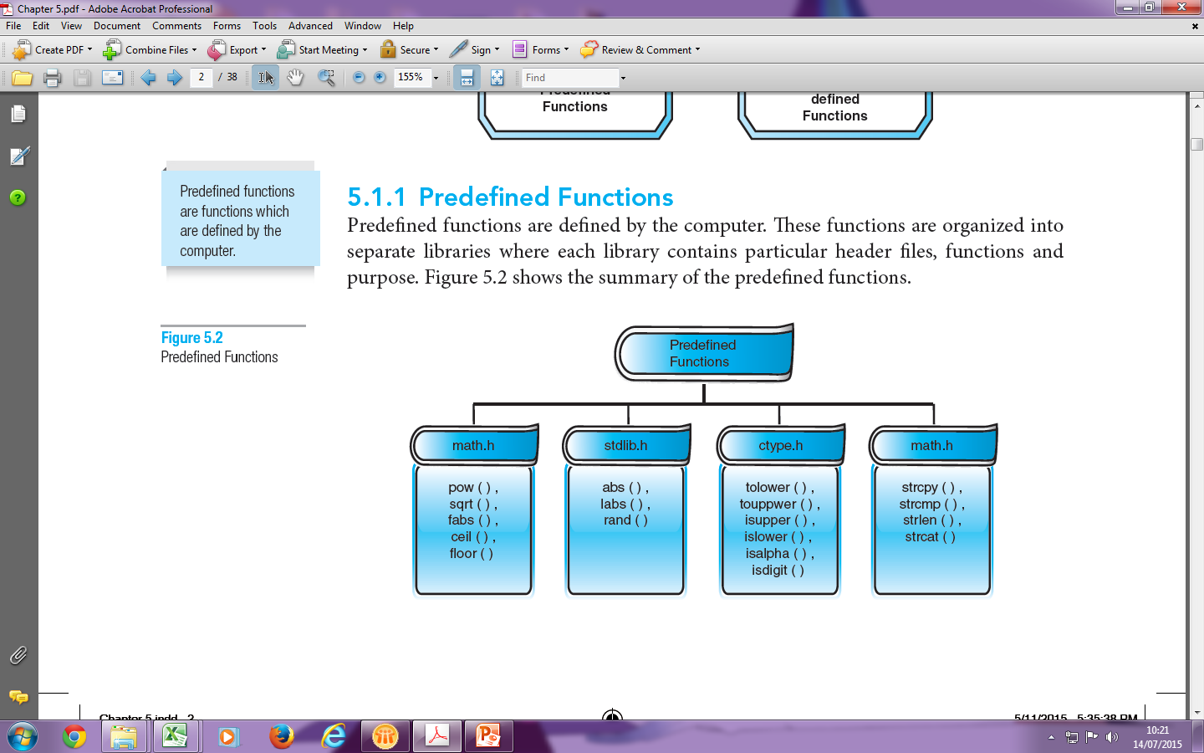
Predefined Functions

Slide 8
User-defined Functions
All C++ programs must contain at least one function, which is the main( ).
Functions must be assigned a name. Similar to variables, each function is given a valid identifier name.
A function name must be followed by parentheses( ).
The characteristics of user-defined functions are:
1. A function name must be unique
2. A function performs a specific task
3. A function is independent
4. A function may receive and return values to the calling function

Slide 9
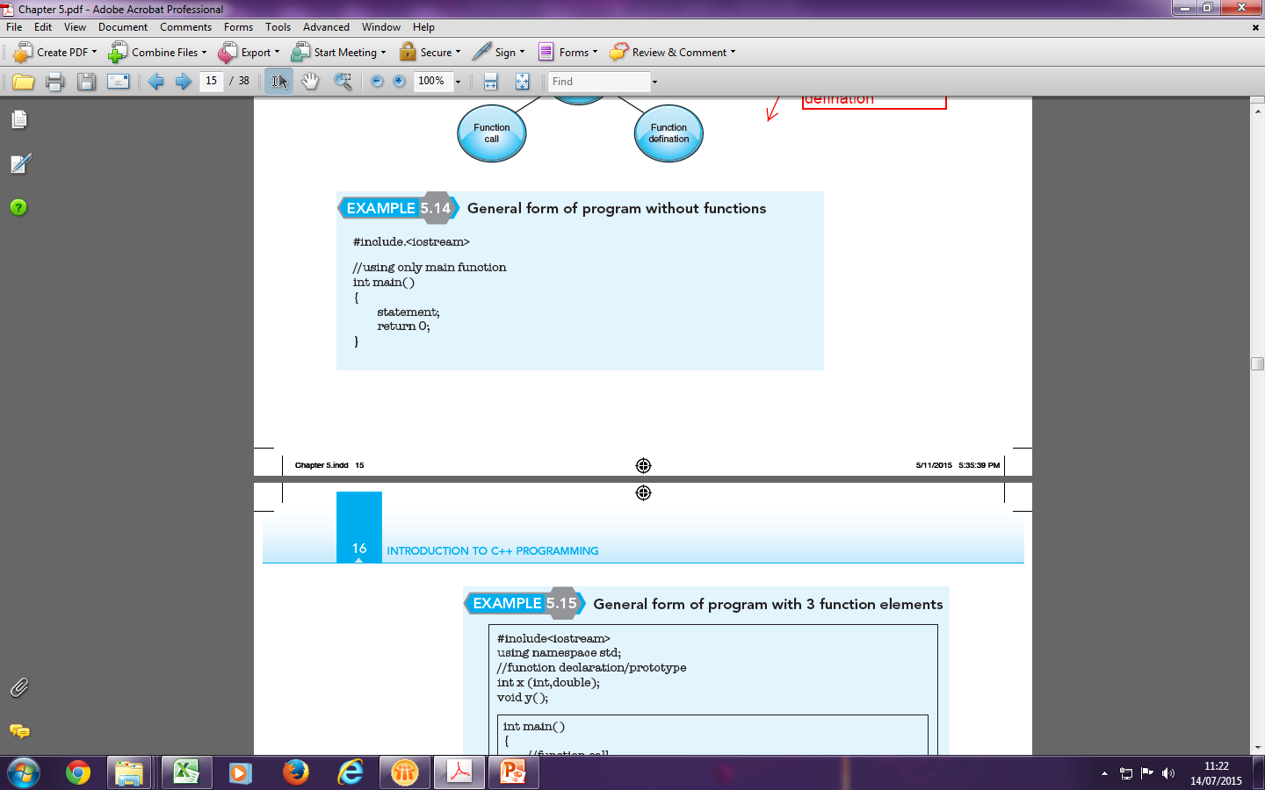
User-defined Functions (cont.)
Function Element
Function prototype/
declaration
Function call
Function definition

Slide 10
Function Declaration/Prototype(cont.)
A function prototype can be written according to the following form:
function_type function_name (parameter list);
  function_type is any data type such as int, double, float, char or void
  function_name is any identifier name as the name must follow the rules in naming identifiers.
  parameter list is any data type which belongs to variables or constants that is passed to the function.
Similar to statements, a function declaration/prototype must end with a semicolon(;).

Slide 11
Function Definition
A function is a sub program which can perform specific tasks.
Function definition will not be used if it is not called by the function call.
To write a function definition, below is the correct form:
function_type function_name (formal parameter list)
{
function_body
}
  function type is any data type such as int, double, float, char or void.
  function_name is any identifier name as the name must follow the rules in naming identifiers
  Formal parameter list is any data type and identifier name that is being passed to the function

Slide 12
Function Definition (cont.)
A parameter list in a function definition is known as formal parameter list.
If there is more than one parameter list, separate them with commas (,).
function_body is enclosed in braces and composed of executable statements such as input, process and output.
A function definition which starts with the function type int, double, float and char must return its value to the function call, whereas if it starts with function type void, the function does not have to return a value.

Slide 13
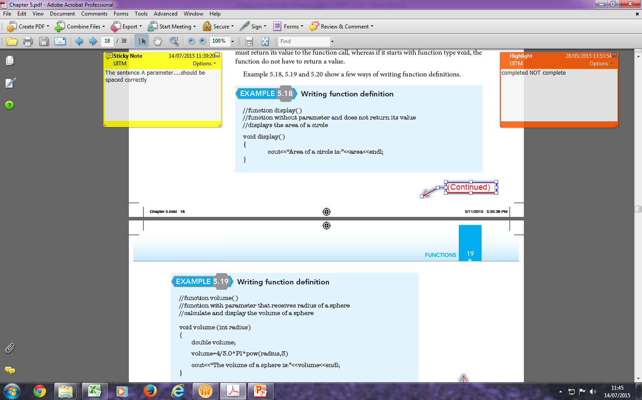
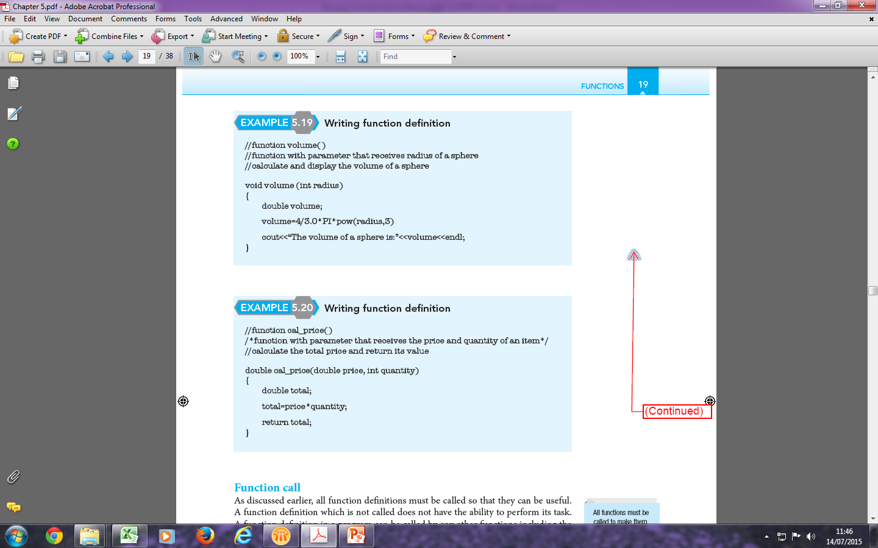
Function Definition (cont.)

Slide 14
Function Call
All function definitions must be called so that they can be useful.
A function definition which is not called does not have the ability to perform its task.
A function definition in a program can be called by any other functions including the main function.
When calling a function, follow the form below:
function_name (actual parameter list);
  function_name is any identifier name as the name must follow the rules in naming identifiers.
  parameter list is any identifier name or value that is being passed to the function.
A parameter list in a function call is known as an actual parameter list. If there is more than one parameter list, separate them with commas (,).

Slide 15
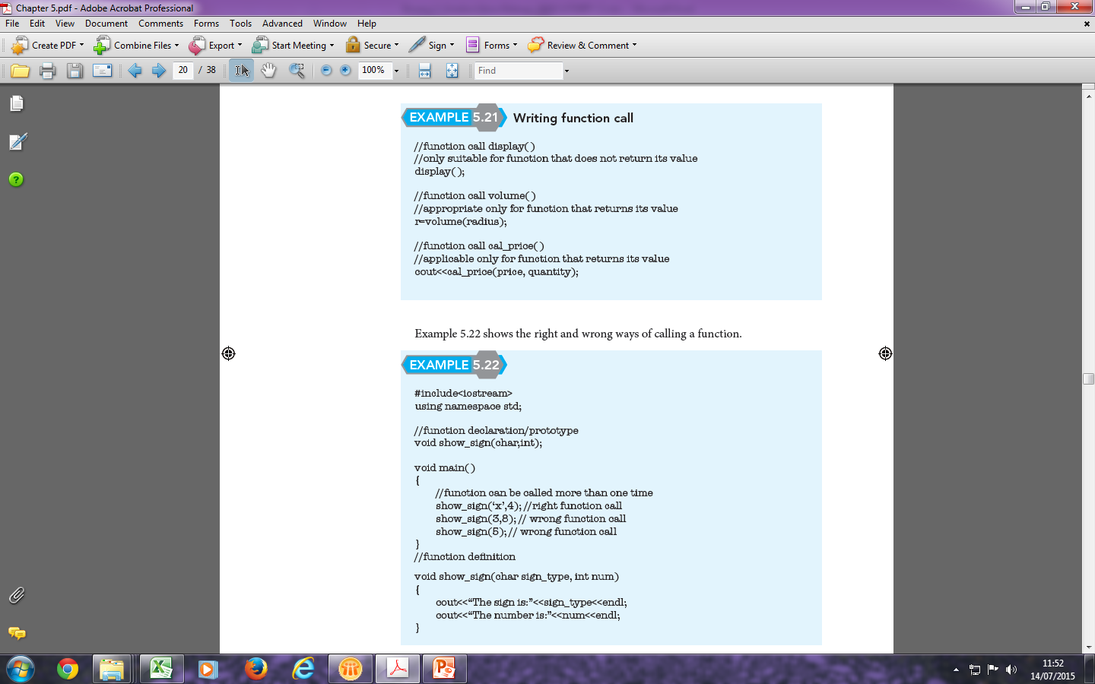
Function Call (cont.)

Slide 16
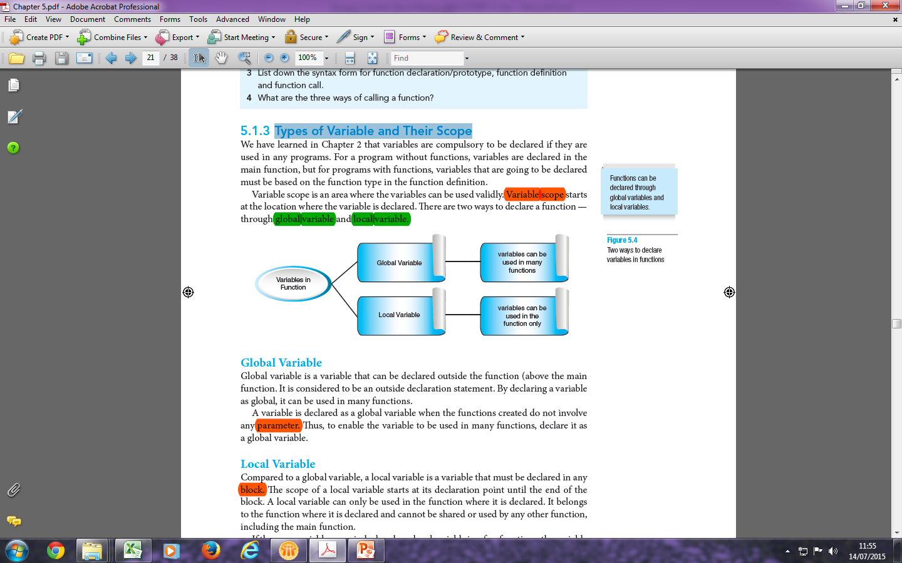
Types of Variable and Their Scope

Slide 17
Function with Return Statement
A function which type is int, char, double or float must return values to the function call.
A function can only return one value at a time.
The syntax to return a value is:
return expression;
    an expression can be in the form of values that match with their type of identifiers.

Slide 18
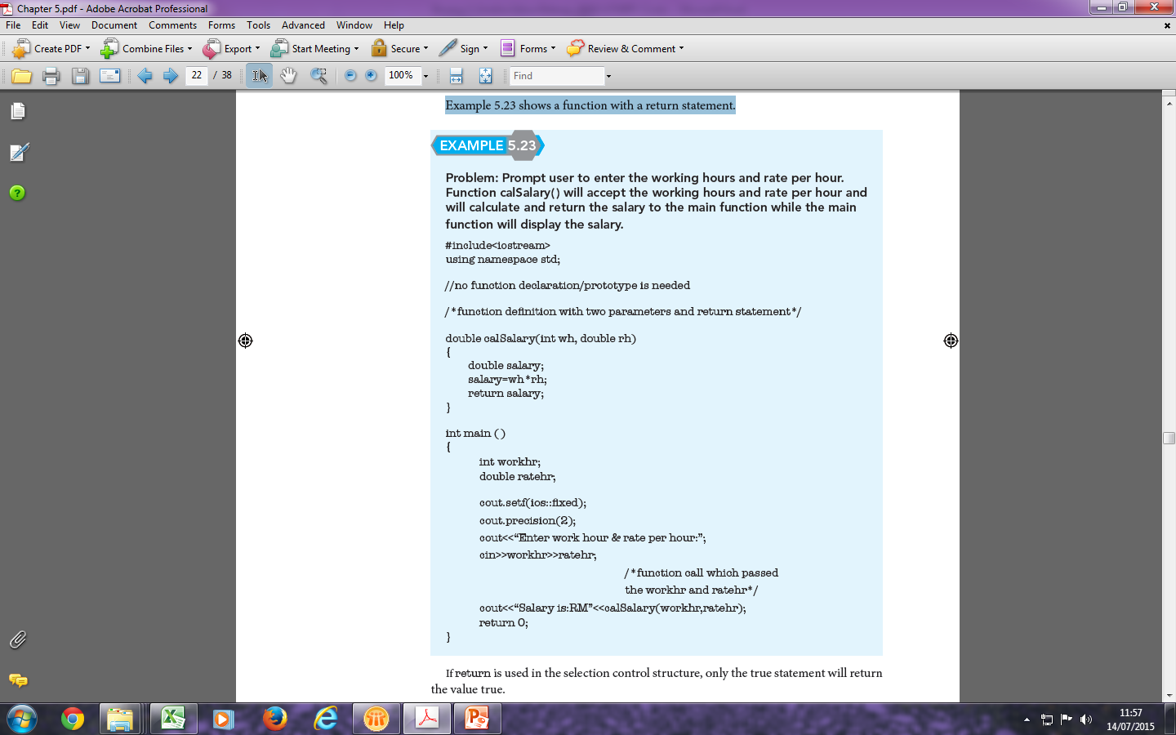
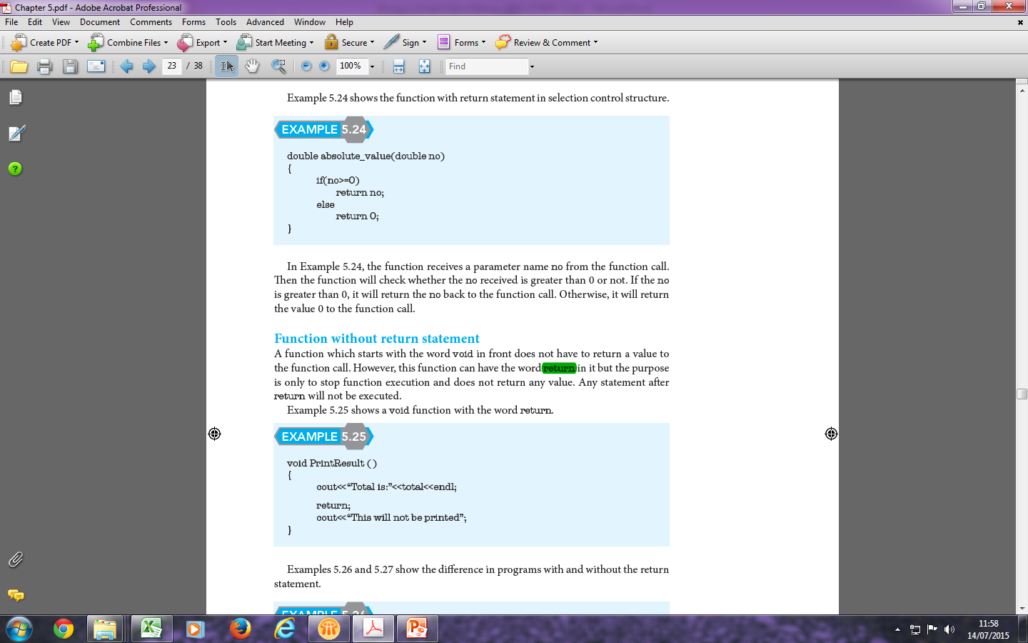
Function with Return Statement (cont.)

Slide 19
Function without Return Statement (cont.)
A function which starts with the word void in front does not have to return a value to the function call.
However, this function can have the word return in it but the purpose is only to stop function execution and does not return any value.
Any statement after return will not be executed.

Slide 20
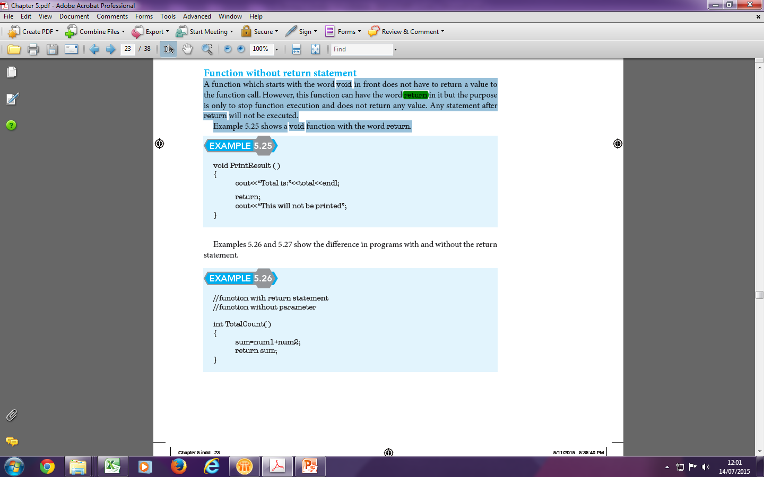
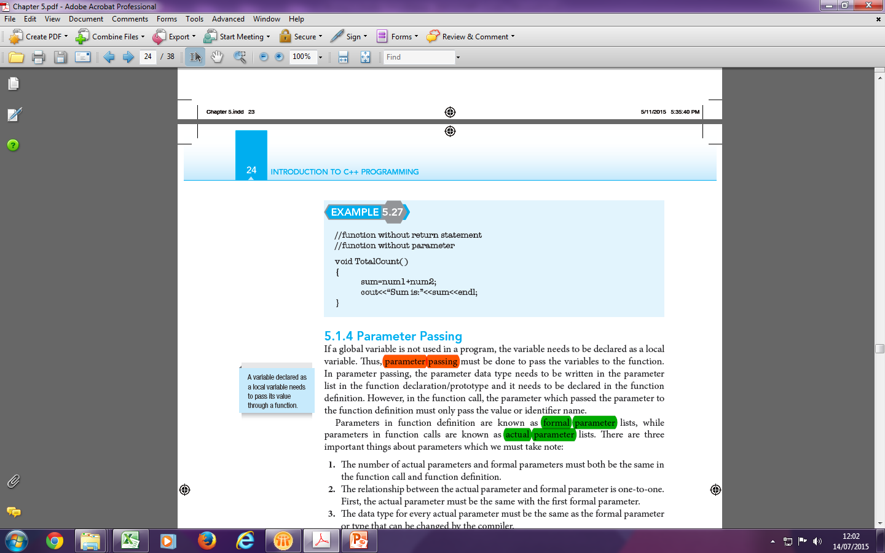
Function without Return Statement (cont.)

Slide 21
Parameter Passing
If a global variable is not used in a program, the variable needs to be declared as a local variable.
Parameter passing must be done to pass the variables to the function.
In parameter passing, the parameter data type needs to be written in the parameter list in the function declaration/prototype and it needs to be declared in the function definition.
However, in the function call, the parameter which passed the parameter to the function definition must only pass the value or identifier name.

Slide 22
Parameter Passing (cont.)
Three important things about parameters:
The number of actual parameters and formal parameters must both be the same in the function call and function definition.
The relationship between the actual parameter and formal parameter is one-to-one. First, the actual parameter must be the same with the first formal parameter.
The data type for every actual parameter must the same as the formal parameter or type that can be changed by the compiler.

Slide 23
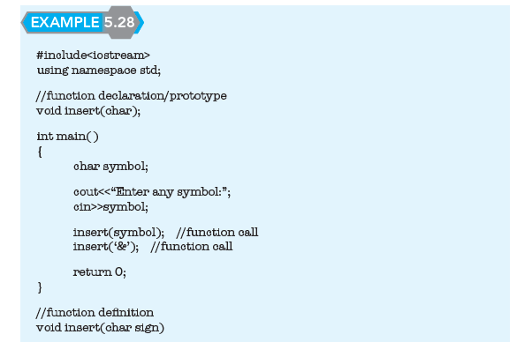
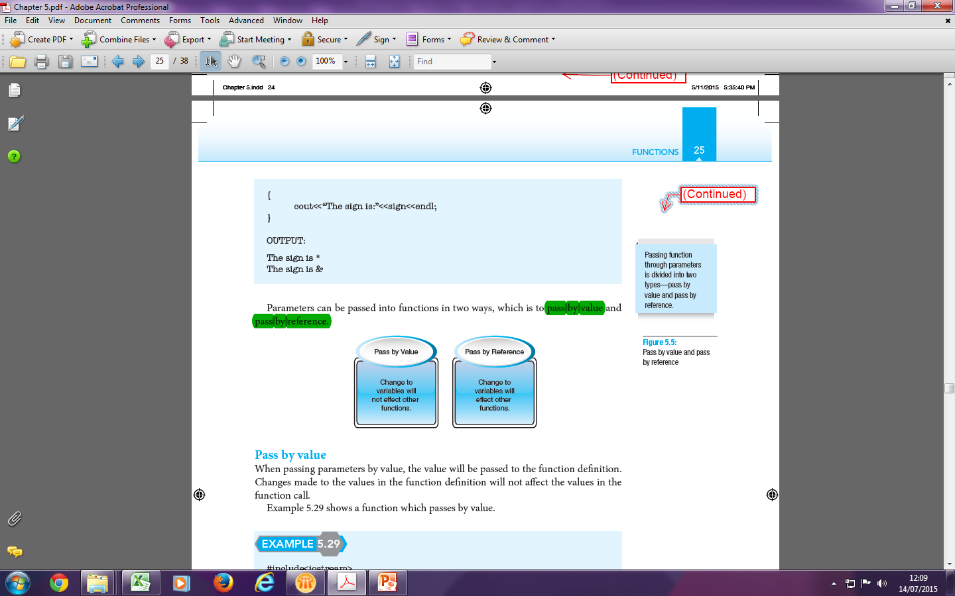
Parameter Passing (cont.)

Slide 24
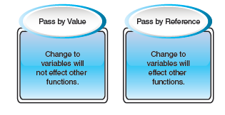
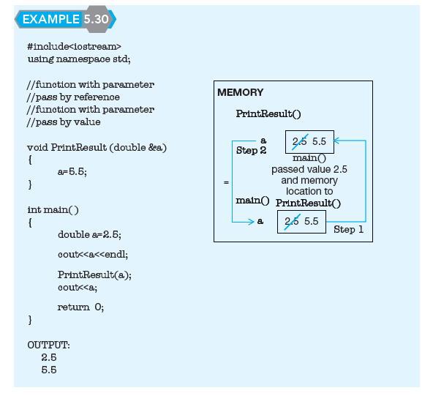
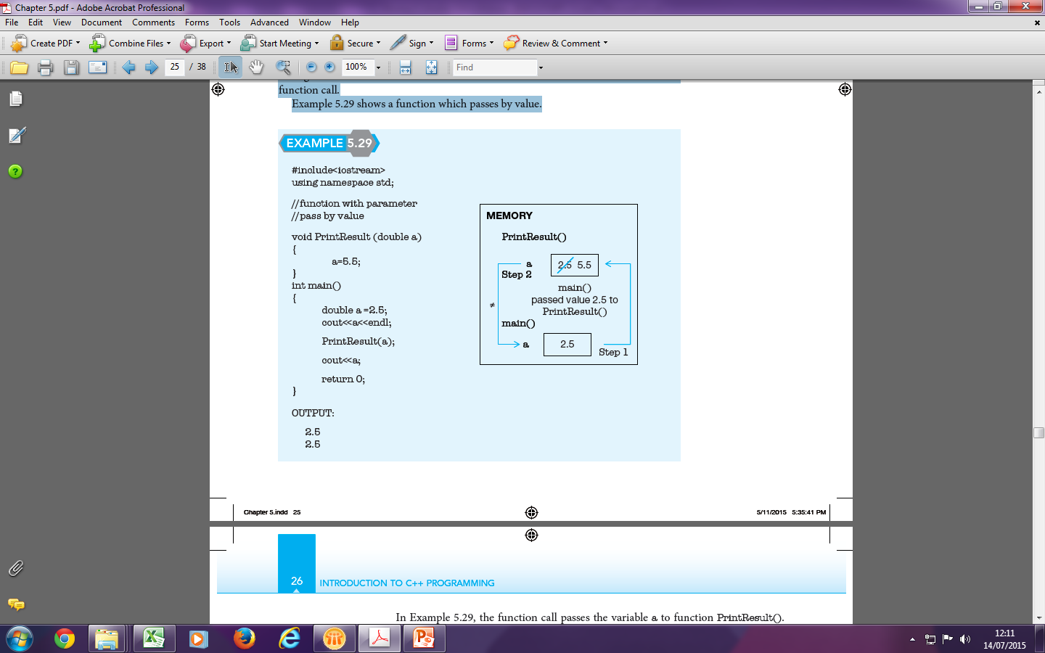
Parameter Passing (cont.)

Slide 25
Comparing: Value vs. Reference
Pass By Value
  The local parameters are copies of the original arguments passed in
  Changes made in the function to these variables do not affect originals
Pass By Reference
  The local parameters are references to the storage locations of the original arguments passed in.
  Changes to these variables in the function will affect the originals
  No copy is made, so overhead of copying (time, storage) is saved

Slide 26
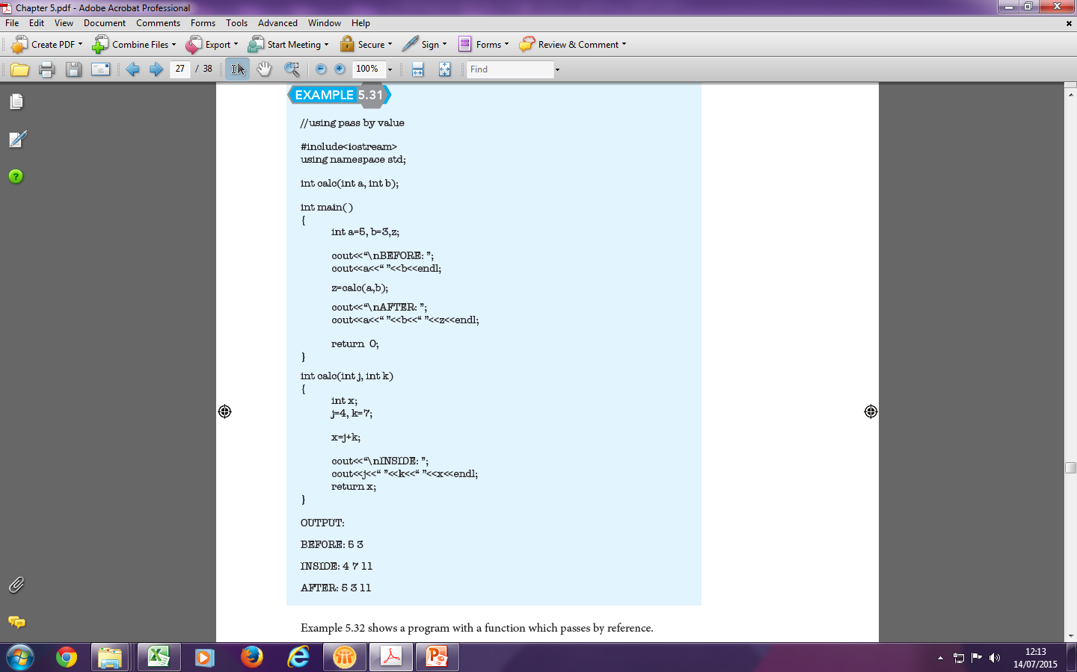
Parameter Passing (cont.)

Slide 27
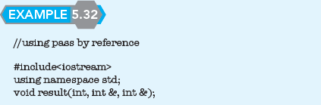
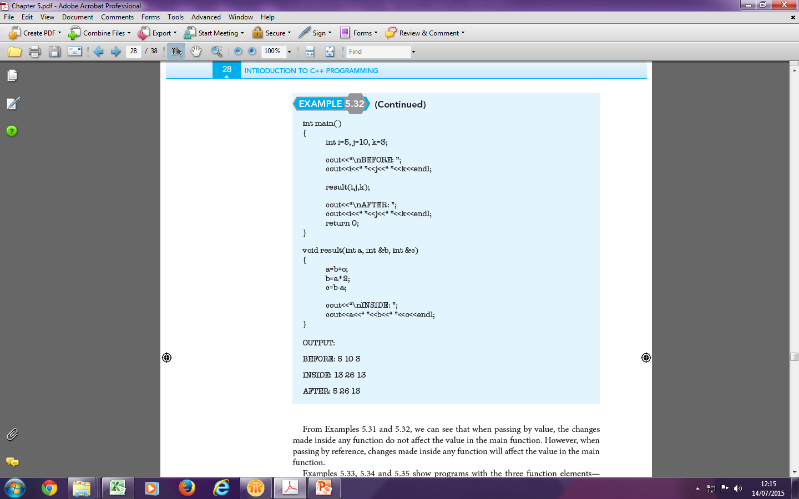
Parameter Passing (cont.)

Slide 28
Exercise 1
Prompt user to enter the working hours and rate per hour. Function calSalary () will accept the working hours and rate per hours. Then, the system will calculate and return the salary to the main function while the main function will display the salary.

Slide 29
Exercise 2
Write a program to calculate the total price of an item by asking the user to input the price and quantity of the item. Set the prototype declaration as cal_price()

Slide 30
Exercise 3
KidsPlayLand offers great discounts for entrance tickets during the school holidays. The following are the prices and discounts given for children and adults.
a. Write a function definition for a function Price() that receives categories in character code and quantity. The function will calculate
and return the total price.
b. Write a function definition for a function named Discount() that receives categories in character code and quantity. The function will calculate and return PriceDisc()
c. Write main function to calculate the total price after discount. The program will call the above function to calculate the total price after discount.
Category | Normal Price (RM) | Discount
Children (C) | 45.00 | 20%
Adult (A) | 5.00 | 5%

Slide 31
Conclusion
Functions can divide problems into sub-problems.
In order to develop programs using functions, the three function elements needed to be identified are function prototype/declaration, function call and function definition.
Writing programs using functions provide many advantages as functions can break a program into smaller items which will be easier for the programmer to code, test and debug.
Each of the functions is reusable where the function can be called many times.
Repeating code in a program can be avoided.

